Slide 1

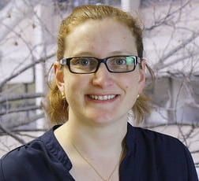
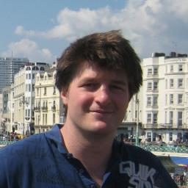



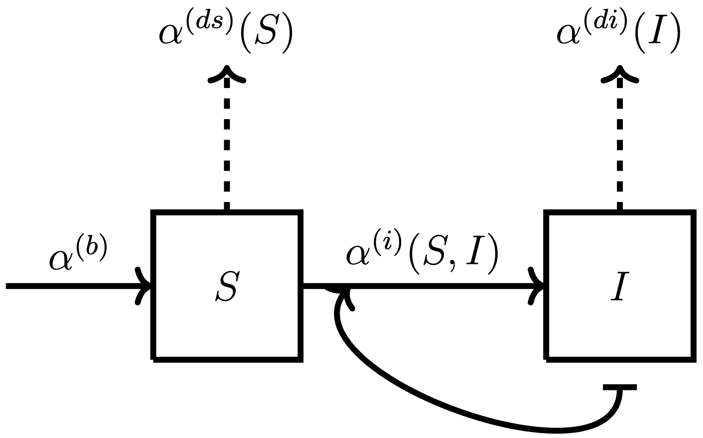
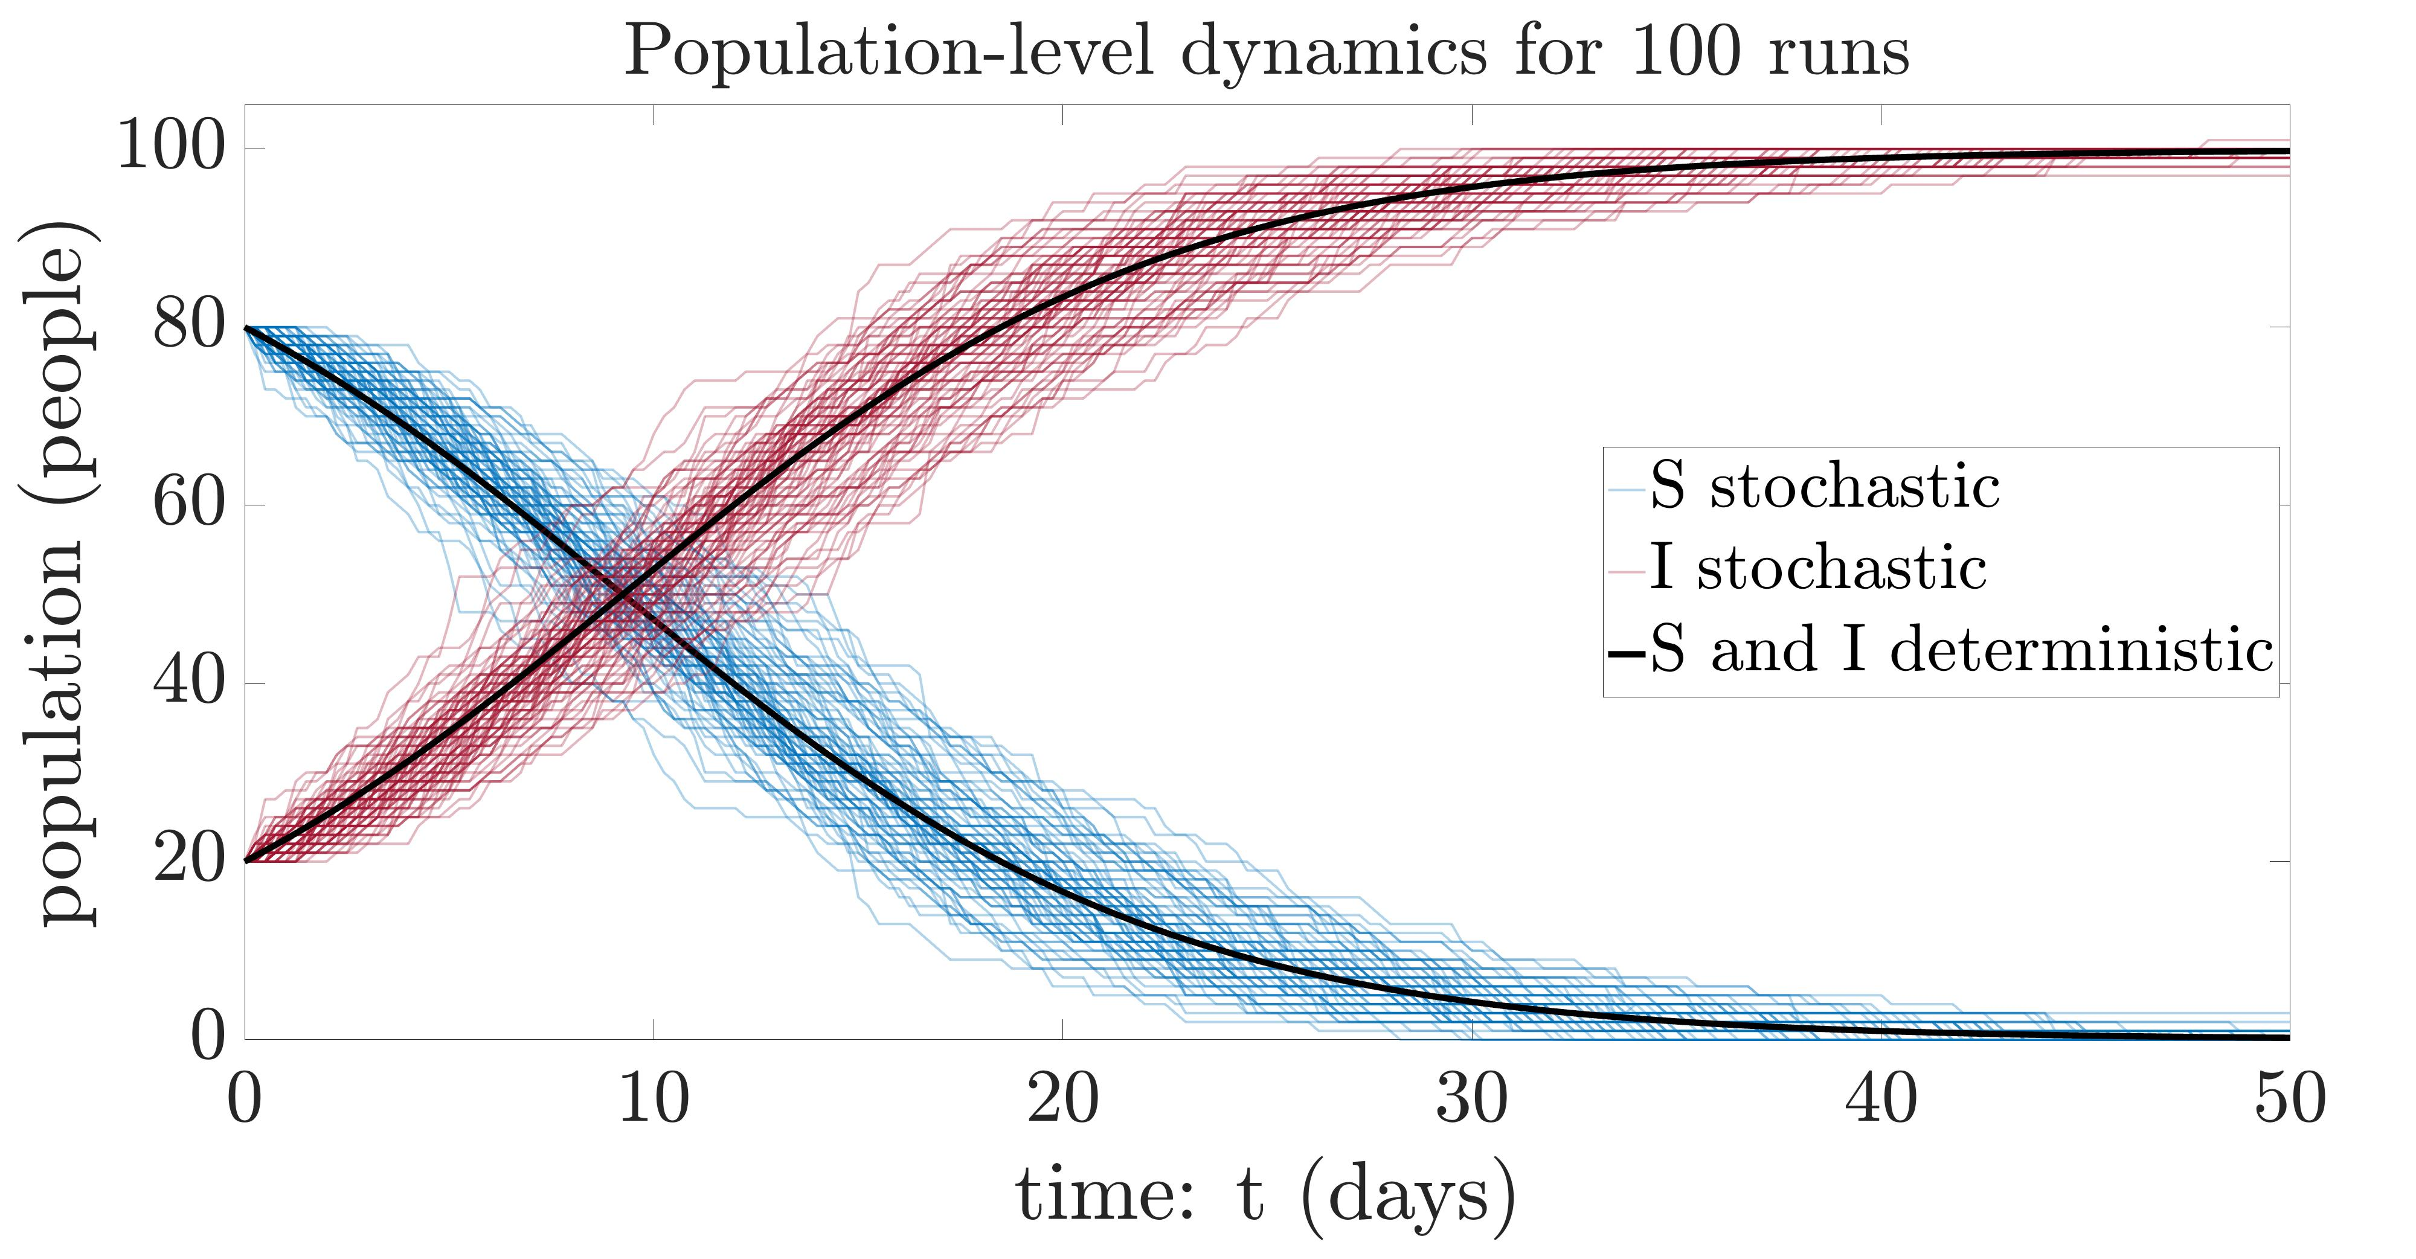
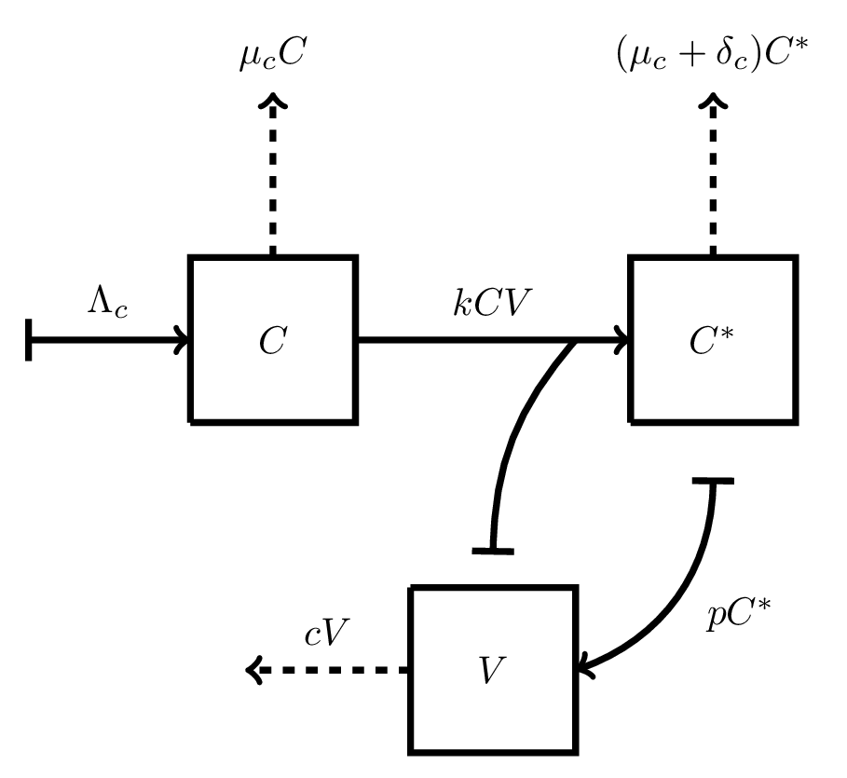
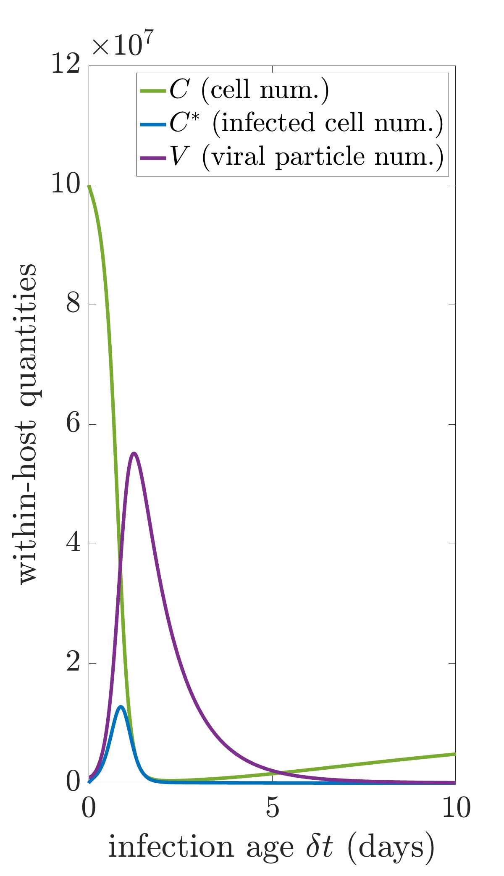
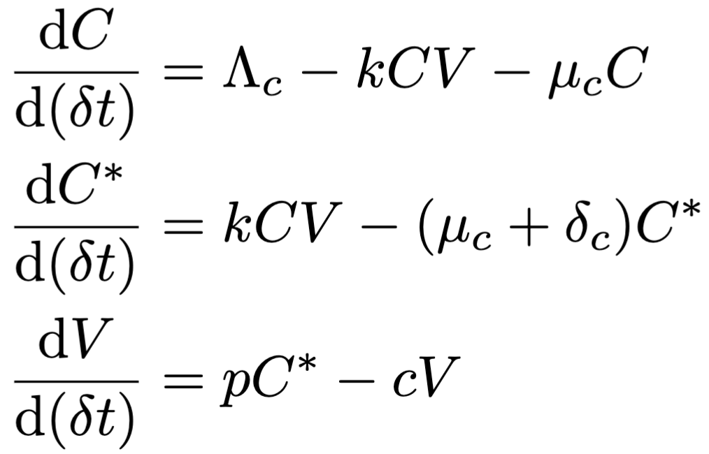
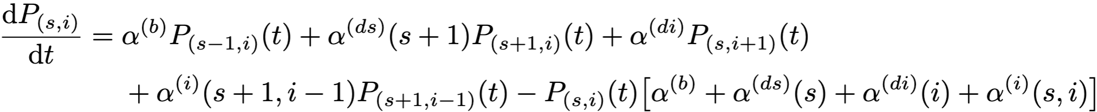
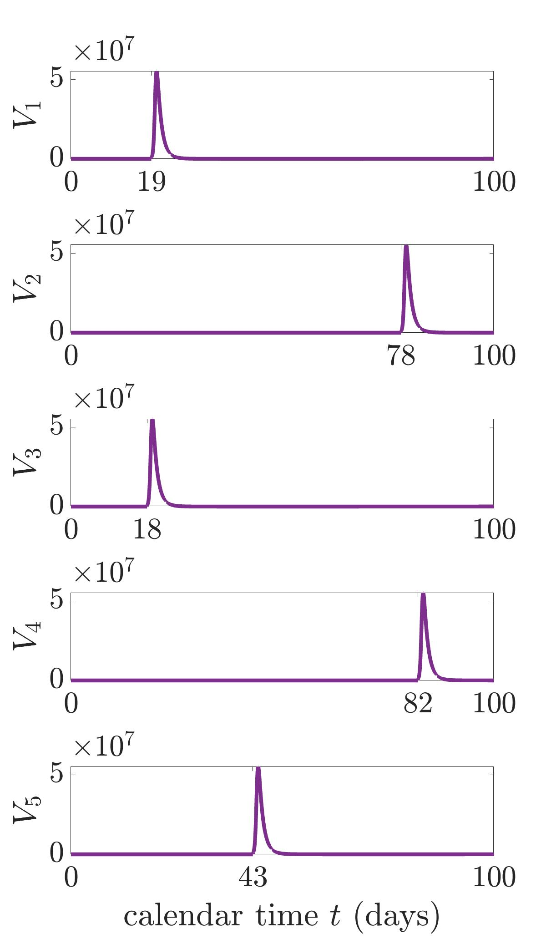
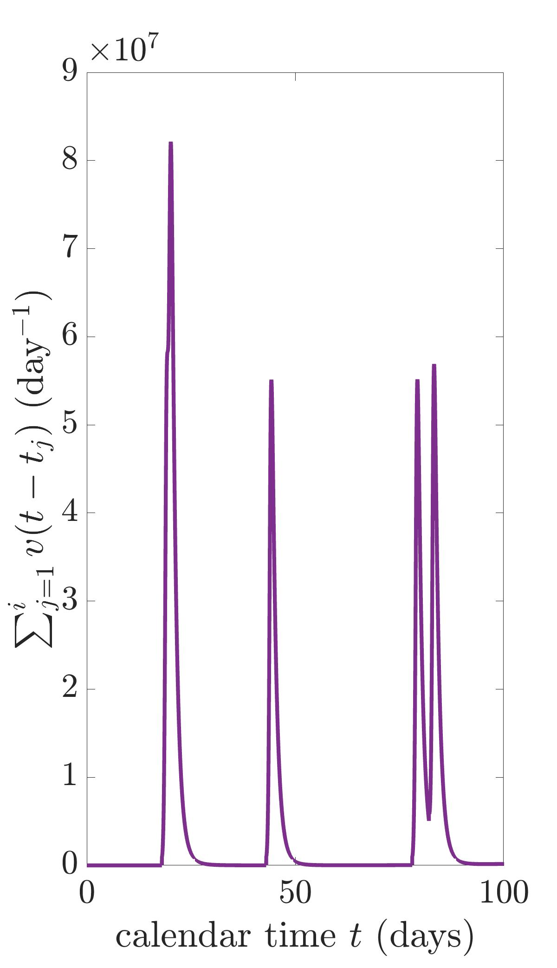
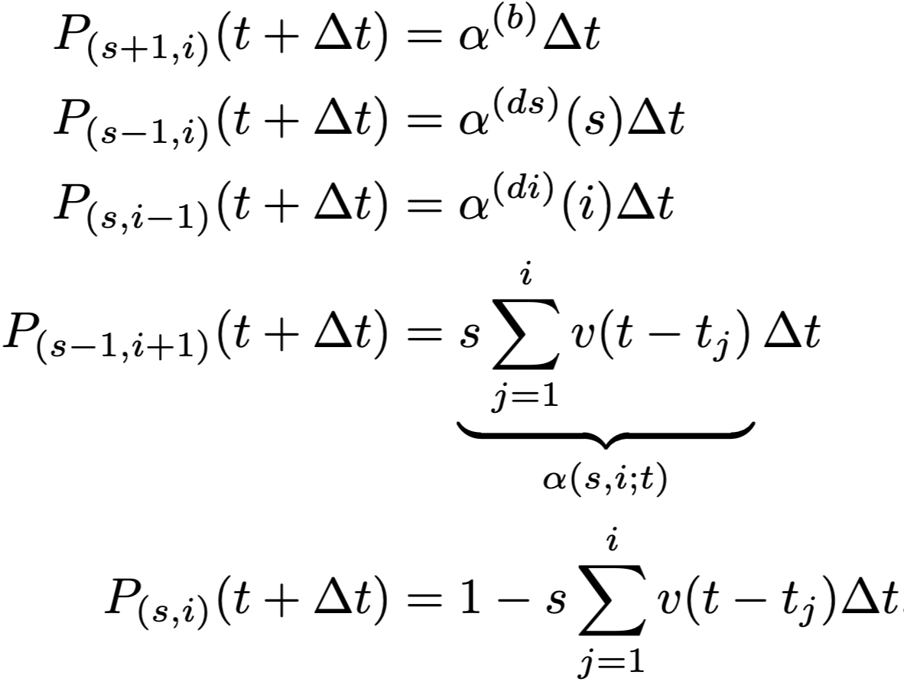
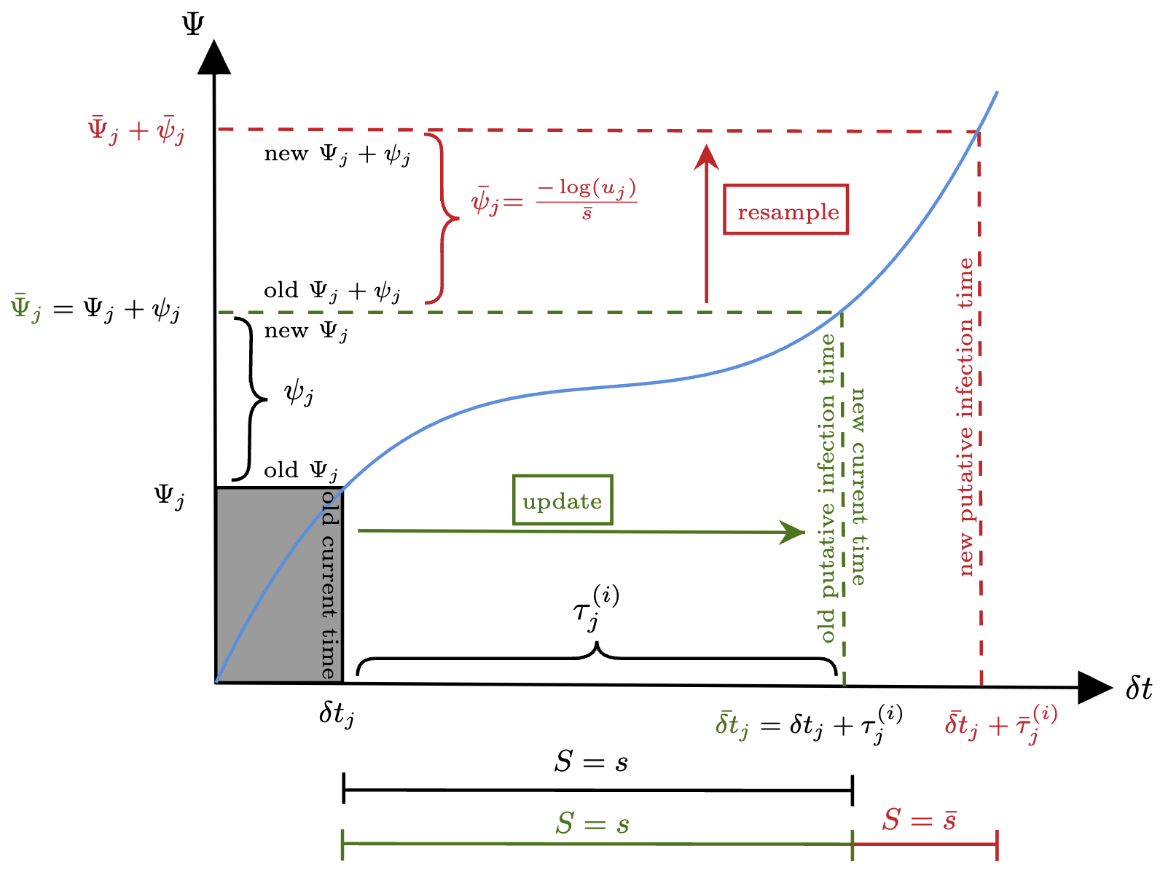
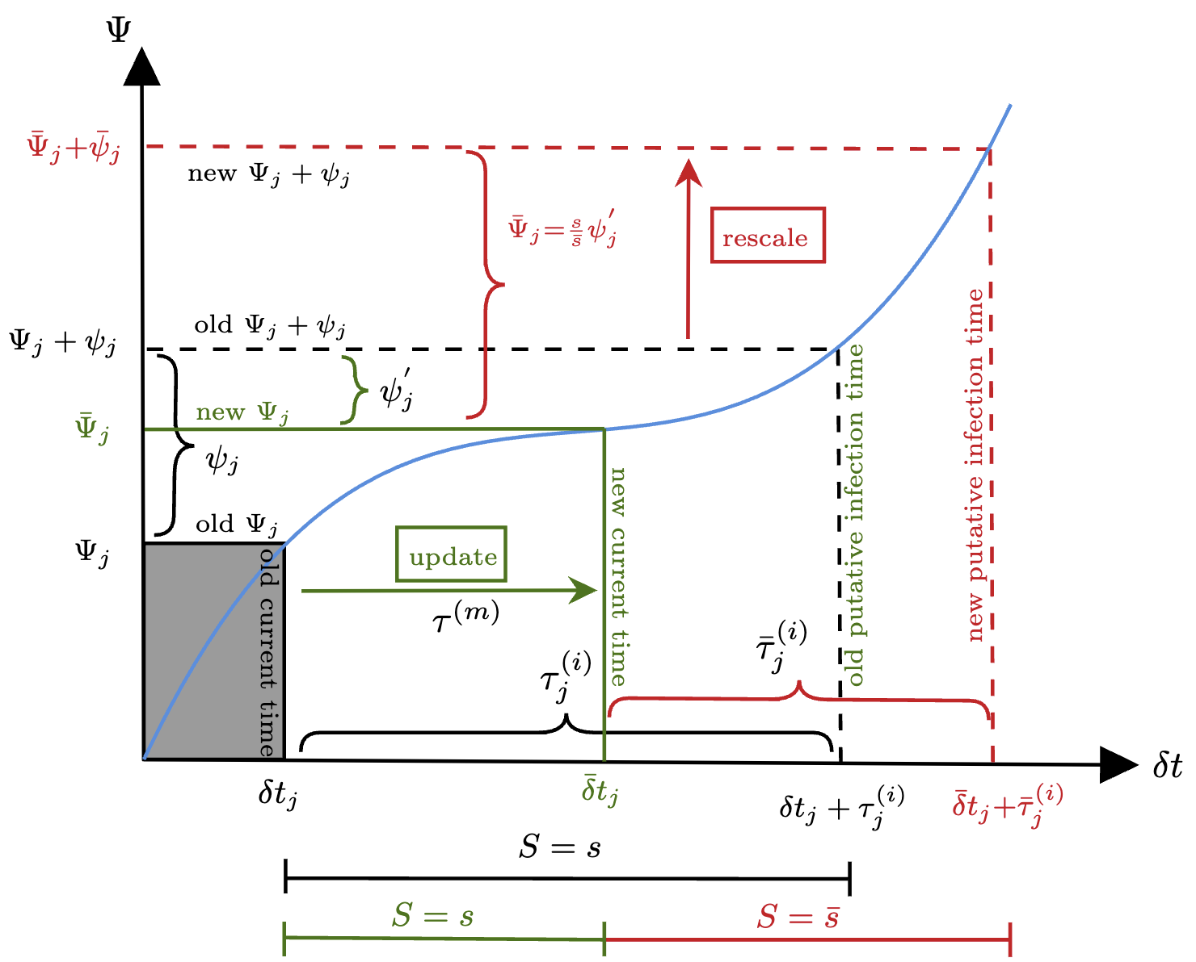
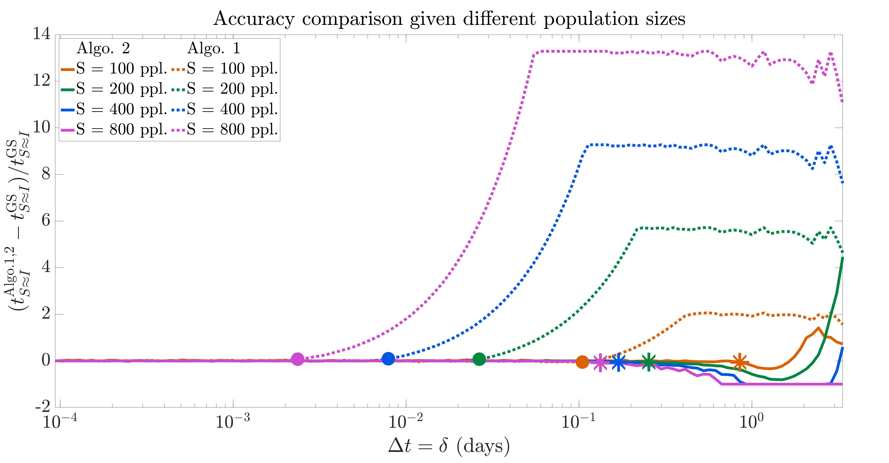
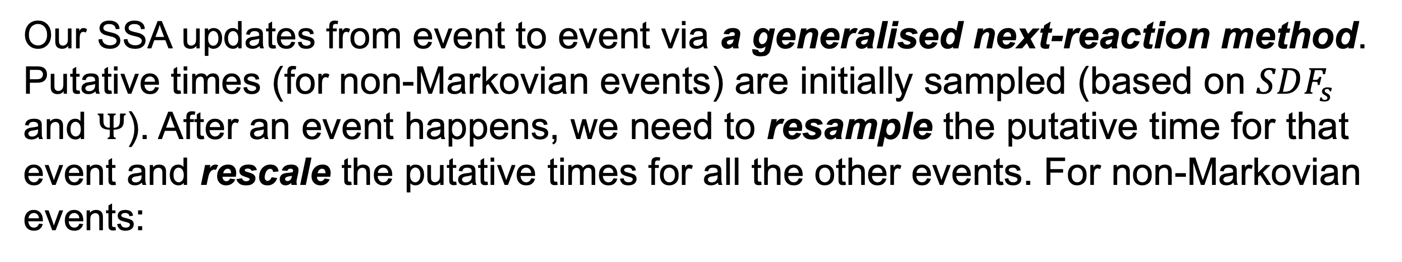
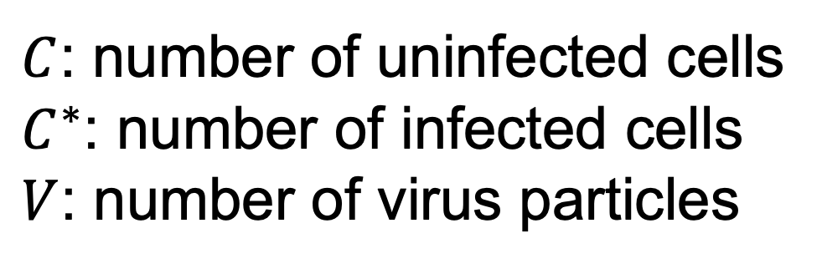




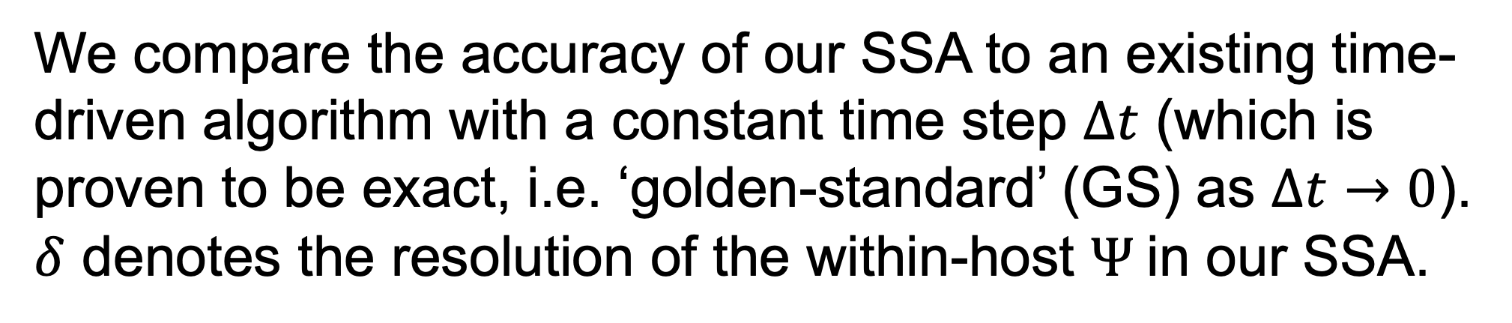
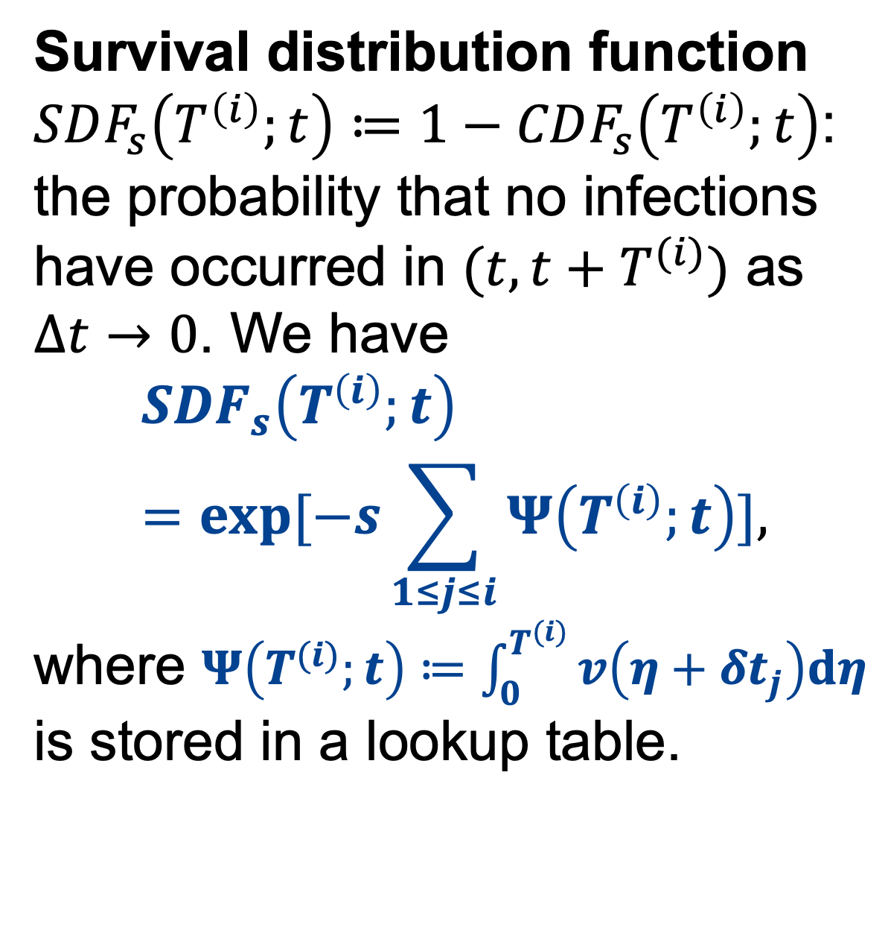



Accurate stochastic simulation algorithm for multiscale models of infectious disease
Yuan Yin¹, Jennifer A. Flegg², Mark B. Flegg³
¹ Mathematical Institute, University of Oxford ² School of Mathematics and Statistics, The University of Melbourne
³ School of Mathematics, Monash University
Twitter (X): @YuanYin_Becca
https://doi.org/10.48550/arXiv.2406.05058
Screenshot 2024-06-17 at 10.50.08.png
Screenshot 2024-06-17 at 10.50.08.png
1. Research gap
2. Contribution of our work
Stochastic simulation algorithms (SSA) for multiscale models of infectious diseases are paid much attention as:
small populations or noise play a crucial rule in real life;
disease dynamics are inherently multiscale (e.g. within-host + across-population dynamics).
Development of a novel exact SSA, applied to a showcase multiscale system with deterministic within-host model and stochastic population-level formulation;
Accuracy, given the within-host information is harvested at a reasonable resolution;
Generality, our SSA can be applied to other multiscale systems in (or outside) the realm of infectious diseases.
Computational challenges when simulating models across different scales (usually non-Markovian) $⇒$ innovations needed!
3. Stochastic population-level model
4. Deterministic within-host model
Screenshot 2024-06-17 at 10.50.08.png
The target cell-limited $CC^{∗}V$ model. Age of infection: $δt$.
The $S$ (susceptible) $−$ $I$ (infectious) model. Calendar time: $t$.
$C$: number of uninfected cells $C^{∗}$: number of infected cells $V$: number of virus particles
def
$P_{(s+m, i+n)}≔$ transition probability of the process from $\left(S, I\right)=\left(s, i\right)$ to $\left(S, I\right)=\left(s+m, i+n\right).$
x
5. Coupling the within-host model to the population-level one: a multiscale showcase
Transmission propensity $α^{(i)}≔βsi$. Model coupling: Agent $j$’s transmission coefficient $β_{j}$ depends on its instantaneous within-host viral load $V_{j}(δt_{j})$: $$β_{j}\left(t\right)=lV_{j}\left(δt_{j}\right) :=v\left(t−t_{j}\right),$$
where $t$ is the current calendar time and $t_{j}$ is the calendar time of agent $j$’s initial infection. $⇒α^{\left(i\right)}\left(s,i;t\right)=s\sum_{1≤j≤i}{v(t−t_{j})}$.
Survival distribution function $SDF_{s}\left(T^{\left(i\right)};t\right)≔1−CDF_{s}\left(T^{\left(i\right)};t\right)$: the probability that no infections have occurred in $(t,t+T^{(i)})$ as $Δt→0$. We have
$$SDF_{s}\left(T^{\left(i\right)};t\right)=exp⁡[−s\sum_{1≤j≤i}{Ψ\left(T^{\left(i\right)};t\right)}],$$
where $Ψ\left(T^{(i)};t\right)≔\int_{0}^{T^{(i)}}{v\left(η+δt_{j}\right)dη}$ is stored in a lookup table.
$${=t}_{1}$$
def
$$t_{2}=$$
def
$${=t}_{3}$$
$$t_{4}=$$
non-Markovian!!
$$t_{5}=$$
def
6. Novel SSA for the multiscale system
7. Novel SSA is exact
Our SSA updates from event to event via a generalised next-reaction method. Putative times (for non-Markovian events) are initially sampled (based on $SDF_{s}$ and $Ψ$). After an event happens, we need to resample the putative time for that event and rescale the putative times for all the other events. For non-Markovian events:
We compare the accuracy of our SSA to an existing time-driven algorithm with a constant time step $Δt$ (which is proven to be exact, i.e. ‘golden-standard’ (GS) as $Δt→0$). $δ$ denotes the resolution of the within-host $Ψ$in our SSA.
resample
rescale
Our SSA
A time-driven algo.
8. Conclusion and future directions
We developed a novel accurate SSA for multiscale systems, incorporating within-host viral load dynamics into individual infection rates in a population-scale infectious disease model. It is general and can be applied to other multiscale systems with different underlying sub-models.
Future directions: 1). Non-deterministic, noisy within-host model for the whole population; 2). Infectious individuals with varying within-host time scales; 3). Heterogeneous populations, such as those with age structures; 4). Investigating the efficiency of our SSA.
This research was supported by The University of Melbourne’s Research Computing Services and the Petascale Campus Initiative. Codes and simulated data are available on Github at https://github.com/Rebecca-yinyuan/MultiscaleSSA.git.
Notes:
Recommended font sizes (not strict):
Title: 85pt
Authors: 56pt
Sub-headings: 36pt
Body text: 24pt
Captions: 18pt

